Slide 1





AI-DRIVEN SECURITY FRAMEWORK FOR IT INFRASTRUCTURE
A Practical Approach to Automated Threat Detection, Risk Evaluation & Compliance for Modern IT Environments
REALISED BY:
LAOULIDI LAHKIM AHMED
EL AMRANI YASSINE
CHERRADI IBRAHIM
SUPERVISED BY:
MR. ZINEDDINE MHAMED
June 2025
Notes:
HELLO everyone. It’s a pleasure to be here today to present the result of several weeks of research, development, and testing. Our project is titled ‘AI-Driven Security Framework for IT Infrastructure’, and as the name suggests, it focuses on automating critical aspects of cybersecurity using artificial intelligence and modern open-source tools.
The objective of this project was to provide a practical, scalable, and intelligent approach to detect cyber threats, evaluate risks, and enforce compliance standards across complex IT environments."

Slide 2


SOMMAIRE
Introduction
Presentation of the Solution
Methodology and Tools Used
Results Achieved
Challenges and Issues Faced
Conclusion
Notes:
"Here’s a quick roadmap of today’s presentation. We’ll begin with an introduction that defines the core context of our work. Next, we’ll describe our proposed solution, the challenges we aimed to address, and the technical architecture we implemented. We’ll also clarify the roles and responsibilities of each team member. Following that, we’ll walk you through the tools and methodology we used to develop and test our framework. Then, we’ll present the results we achieved, analyze the obstacles we encountered, and finally conclude with the main takeaways and future improvement paths."

Slide 3



PROBLEM STATEMENT
CONTEXT:
With the continuous increase in cyber threats and the growing importance of compliance in IT environments, organizations face significant challenges in ensuring security and regulatory adherence.
MAIN QUESTION:
How can we detect threats and ensure compliance automatically and in real time across modern IT systems?
Notes:
"Let’s start by explaining the motivation behind this project. In today’s digital landscape, organizations face an ever-growing number of cyber threats, ranging from malware infections to privilege escalation attacks. Simultaneously, they must comply with regulatory frameworks such as ISO 27001, NIST, or GDPR to avoid legal risks and reputational damage. Traditionally, this has involved manual monitoring, reactive responses, and a heavy dependence on human oversight. But with the increasing complexity and volume of data in IT systems, this is no longer sustainable. So, we asked ourselves: How can we detect threats and ensure compliance automatically and in real time across modern IT systems?

Slide 4



PRESENTATION OF THE SOLUTION
Notes:
Now, let’s move on to the presentation of our solution.

Slide 5


OBJECTIVES
Centralize Log Collection and Analysis (SIEM)
Automate Anomaly Detection
Intelligent Vulnerability Assessment
Predictive Risk Evaluation
Compliance Automation
Notes:
Our main objectives were to :
Centralize log collection using a SIEM setup.
Automate anomaly detection using AI.
Perform intelligent vulnerability assessments.
Predict security risks based on historical patterns.
And automate compliance checks using known standards like ISO and NIST.

Slide 6
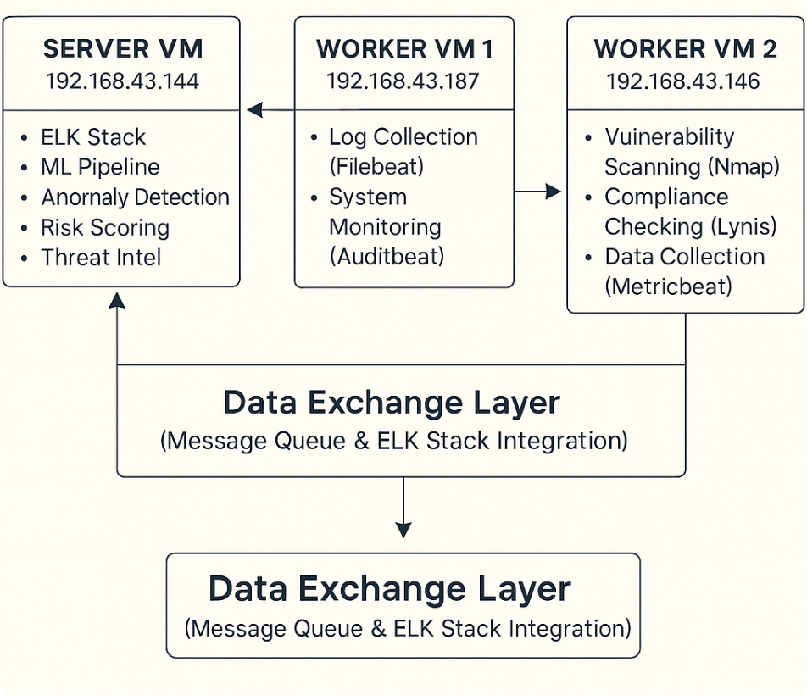
SYSTEM ARCHITECTURE
Notes:
"Let me explain the system architecture we implemented for this project.
Our framework is structured around three main virtual machines, each with its own specific mission:
First, we have the Server VM. This is the central brain of our solution. It hosts the ELK Stack for log management and visualization, runs our machine learning pipeline for anomaly detection and risk scoring, and aggregates all security intelligence.
Next is Worker VM 1. This machine is responsible for collecting logs and monitoring the system. It uses Filebeat to gather log files and Auditbeat to track system events and user activities, sending everything to the server for centralized analysis.
Then, Worker VM 2 acts as our security inspector. It performs vulnerability scanning with tools like Nmap, runs compliance checks using Lynis, and collects metrics with Metricbeat. Its goal is to identify weaknesses and ensure compliance across our environment.
All these components are connected via a Data Exchange Layer, which is implemented as a message queue integrated with the ELK Stack. This ensures that logs, scan results, and alerts flow seamlessly between all VMs in real time, making the whole framework reliable and scalable.

Slide 7
METHODOLOGY AND TOOLS USED
Notes:
Let’s now discuss methodology and tools used
.

Slide 8






TECHNOLOGIES USED
LOG COLLECTION & SIEM
MACHINE LEARNING
VULNERABILITY SCANNING
Notes:
_"To implement this architecture, we selected a range of robust, open-source technologies, each chosen for its reliability and performance in real-world environments. Here are the main components:
Elasticsearch, Logstash, and Kibana form the backbone of our SIEM solution—allowing us to collect, store, and visualize logs efficiently.
Filebeat and Auditbeat act as lightweight agents on the workers, shipping logs securely and in near real-time.
For the AI component, we used Scikit-learn to train anomaly detection and classification models based on historical log data.
OpenVAS is used for vulnerability detection, helping us identify potential entry points for attackers. These technologies were fully integrated to deliver an end-to-end automated threat detection and compliance framework."_

Slide 9
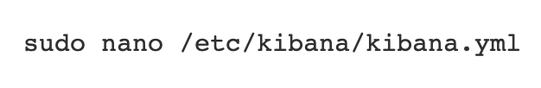
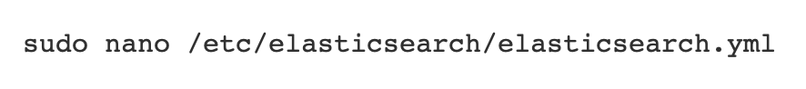
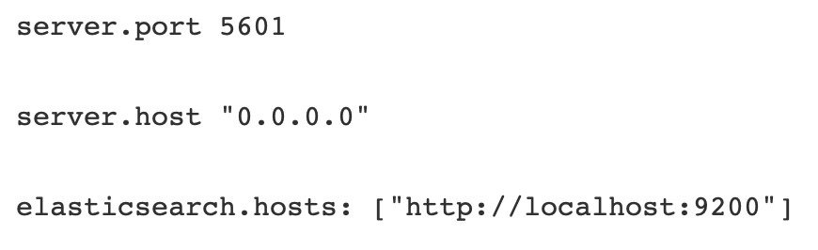
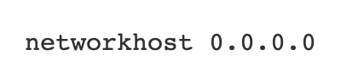
Notes:
"Here, you can see some key details of how we configured Kibana and Elasticsearch. Kibana was set to listen on port 5601, and was bound to all network interfaces using 0.0.0.0, allowing access from both worker machines. Similarly, Elasticsearch was configured to expose its API to all IPs, enabling indexing requests from the workers. These settings were essential to ensure that logs could be visualized live in Kibana dashboards from remote agents. We also secured access through user authentication and role-based controls to avoid unauthorized queries."

Slide 10
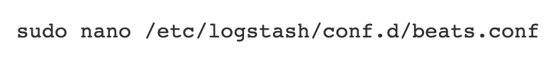
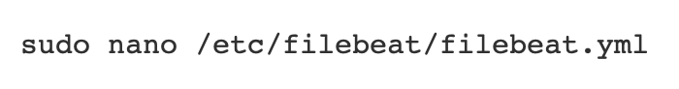
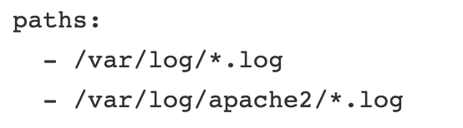
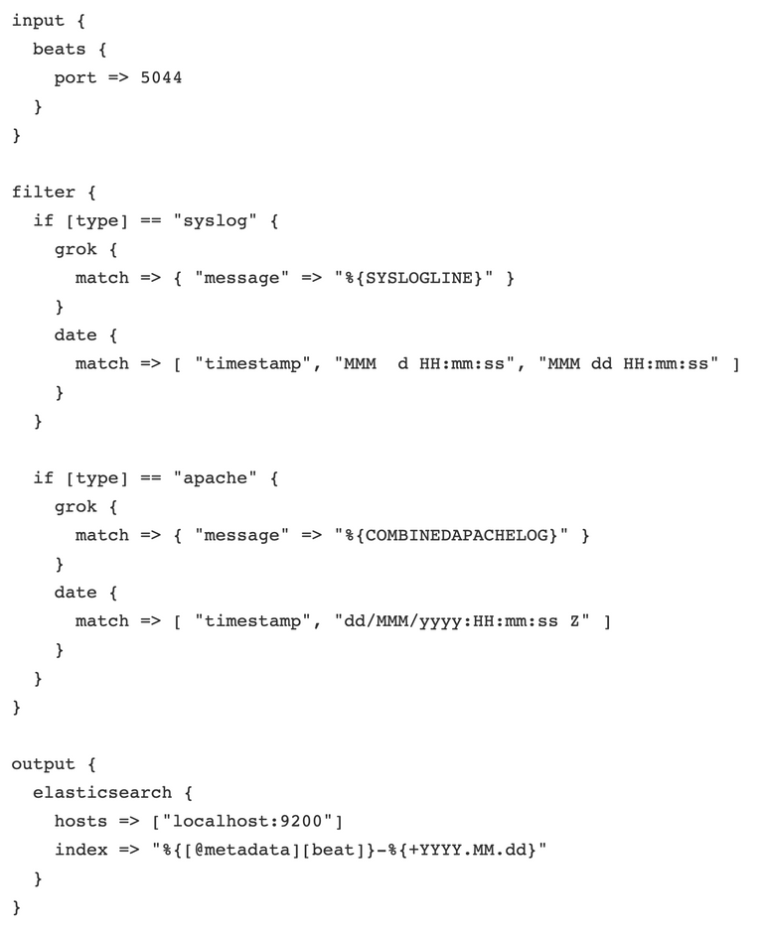
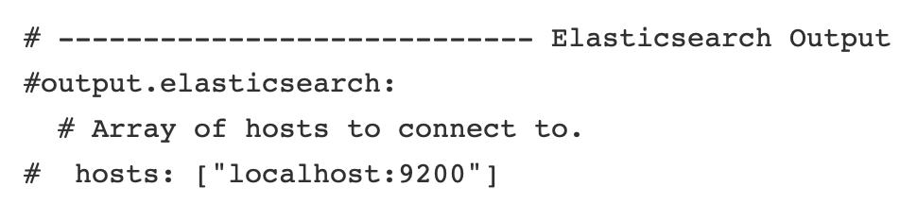
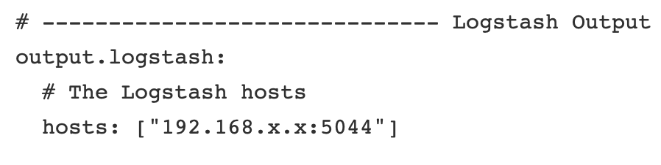
Notes:
"The diagram on this slide shows how log collection and parsing were handled using Logstash and Filebeat. Filebeat is installed on the workers and is configured to watch several directories, including /var/log/syslog, /var/log/auth.log, and Apache logs. These logs are sent via port 5044 to Logstash, which applies different filters based on the log type. We used the Grok filter plugin in Logstash to extract structured data—such as timestamps, IP addresses, and event types—from raw log messages. This normalized data is then forwarded to Elasticsearch, where it becomes queryable and visualizable in Kibana. Thanks to this real-time flow, we could track system activity with minimal latency."

Slide 11
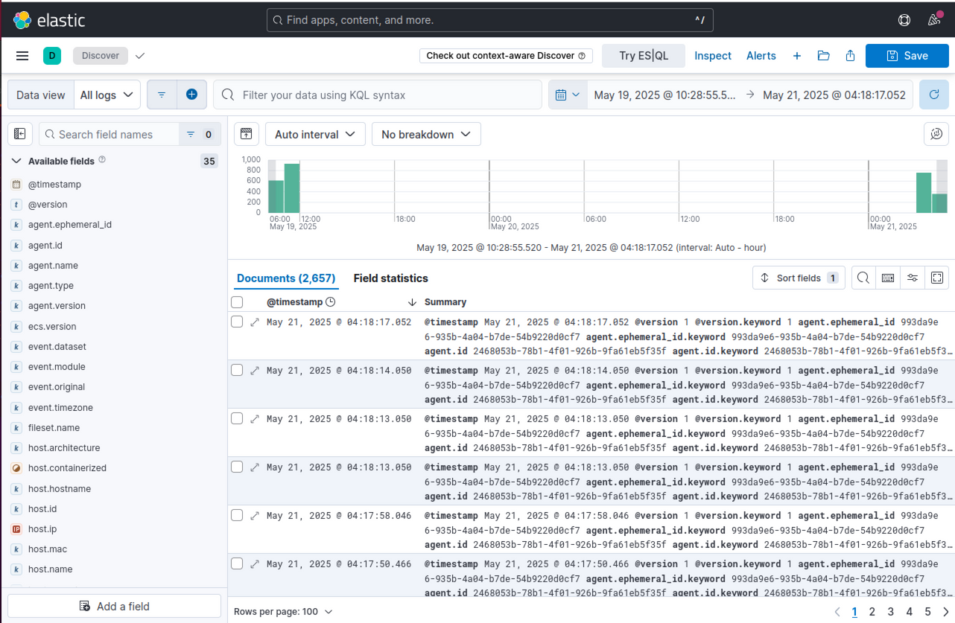
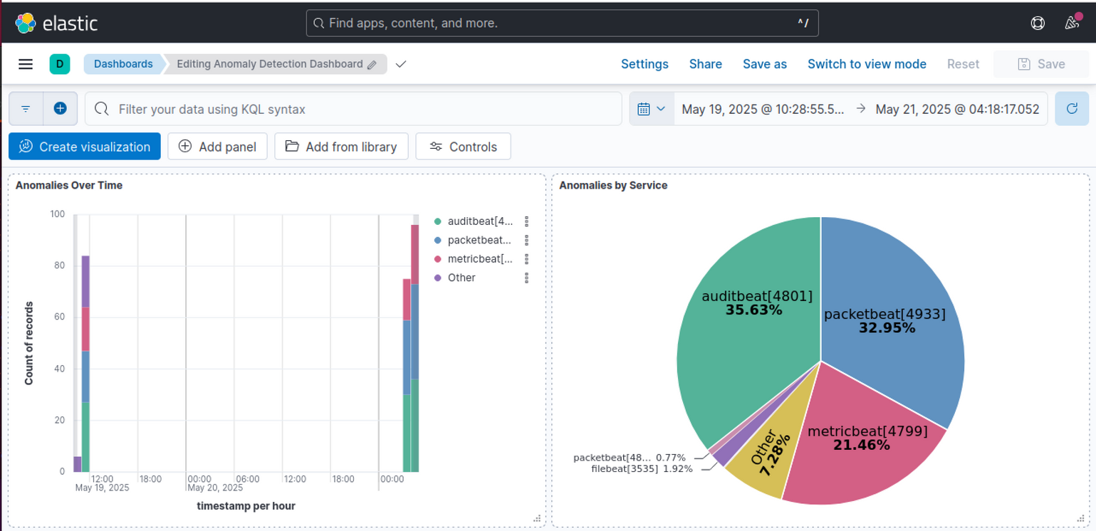
LOGS VISUALISATION
Notes:
"Once logs are processed and stored, the next step is visualization, which is done using Kibana. We created multiple custom dashboards that display data in different formats—pie charts, bar graphs, time series, and data tables. For instance, one dashboard shows SSH login attempts, including failed logins, IP origins, and login success rates. Another dashboard shows file access and modification patterns, which is critical for detecting unauthorized access or tampering. These dashboards not only make the data easier to analyze but also support real-time alerting through Kibana Watcher and Elasticsearch queries. This enables us to catch threats early and trigger alarms or scripts automatically."

Slide 12
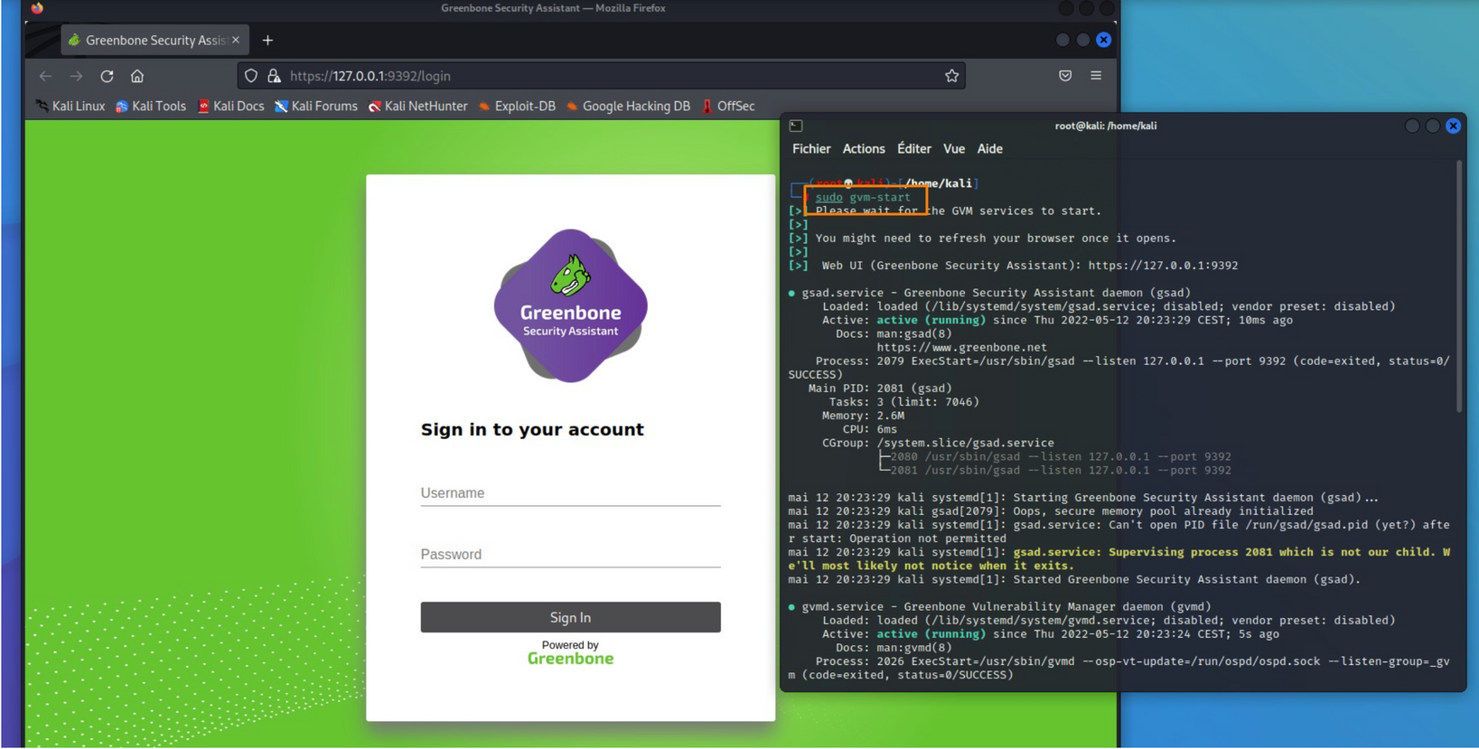

OPENVAS INTERFACE
Notes:
On this slide, you can see the interface of Greenbone Security Assistant, which is the web dashboard for OpenVAS.
On the left, we have the login screen, where authorized users can access the vulnerability management platform.
On the right, you see the terminal where we start the necessary OpenVAS services using the command line.
OpenVAS is our main tool for automated vulnerability scanning. It allows us to scan target systems for known security issues, exposed services, and misconfigurations. The results from these scans are then integrated into our central SIEM and machine learning pipeline for correlation and further analysis.
By using OpenVAS, we are able to identify security weaknesses in real time and take a proactive approach to risk management across our infrastructure.
This integration ensures our solution is not only monitoring for threats but also continuously checking the security posture of all connected systems.

Slide 13
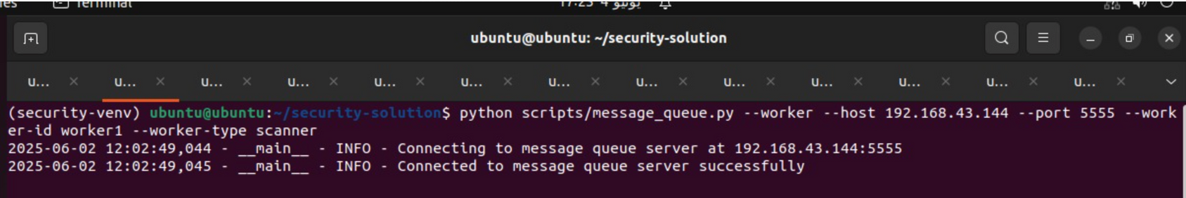
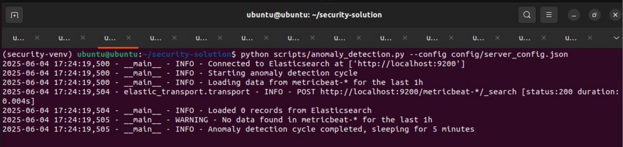
ML FILES
Message Queue
Anomaly Detection
Notes:
Let’s now focus on the machine learning modules that automate our security monitoring process.
At the top, you see the Message Queue script in action. Its job is to ensure smooth, real-time communication between our server and worker VMs. Whenever a worker collects new log data, this script transmits it to the server efficiently and reliably, making our architecture both scalable and responsive.
Just below, we have the Anomaly Detection maodule. This script constantly pulls log and metric data from Elasticsearch, then uses our ML pipeline to spot suspicious behaviors. For example, it can detect unusual login attempts, failed services, or any log pattern that doesn’t fit normal activity. This process is automatic and happens continuously, enabling us to catch threats in real time without manual intervention."

Slide 14
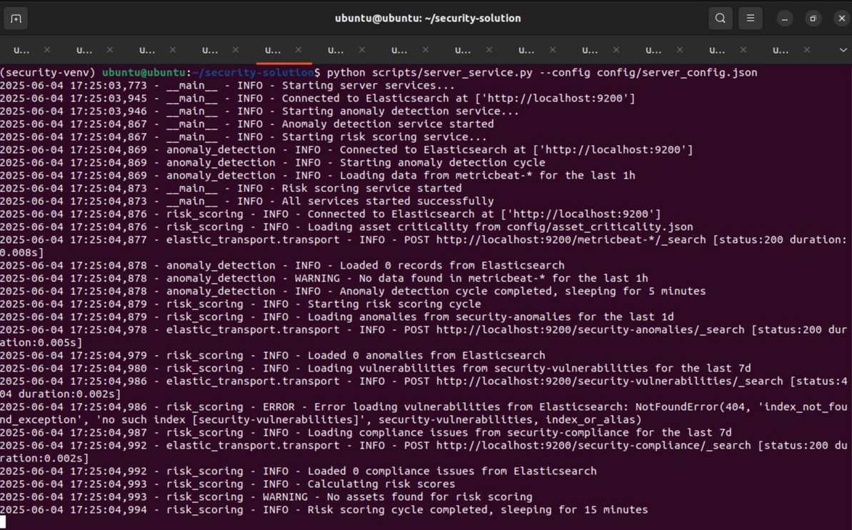
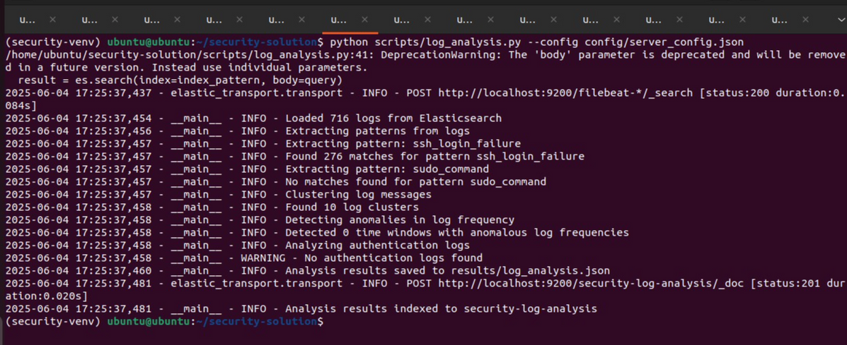
ML FILES
Server Service
Log Analysis
Notes:
On this slide, we dive into two more crucial ML components.
On the left, the Server Service script acts as the central brain of our security automation. It coordinates the execution of all our analytics tasks—starting anomaly detection, risk scoring, and ensuring all other modules are running smoothly.
On the right is our Log Analysis module. Here, we use clustering and pattern recognition to make sense of all incoming log data. The system groups similar log events together, extracts key patterns, and detects outliers or attack signatures. For instance, if a user suddenly starts issuing a large number of sudo commands, the system will automatically flag this behavior for review.
Together, these two modules give us continuous insight and advanced analytics, reducing false positives and helping us prioritize genuine security threats

Slide 15
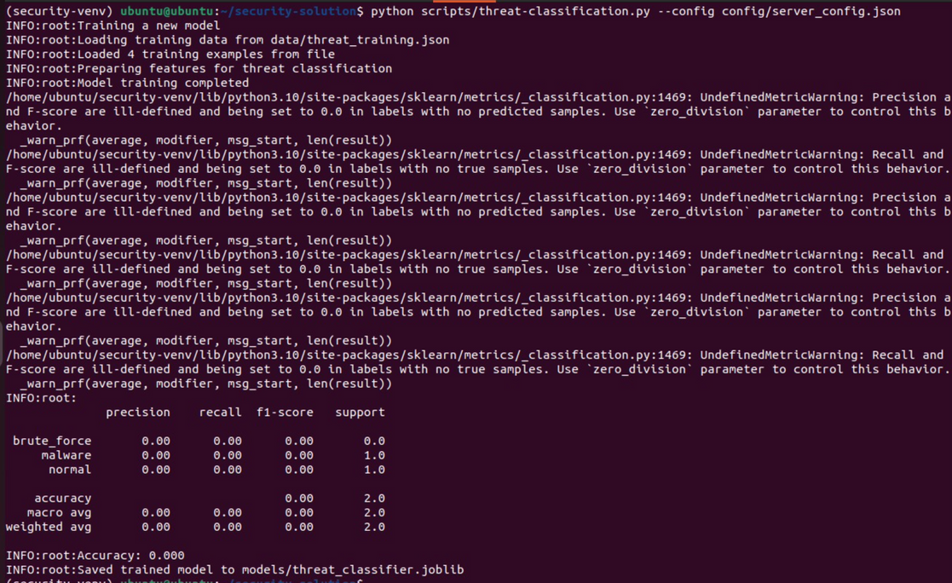
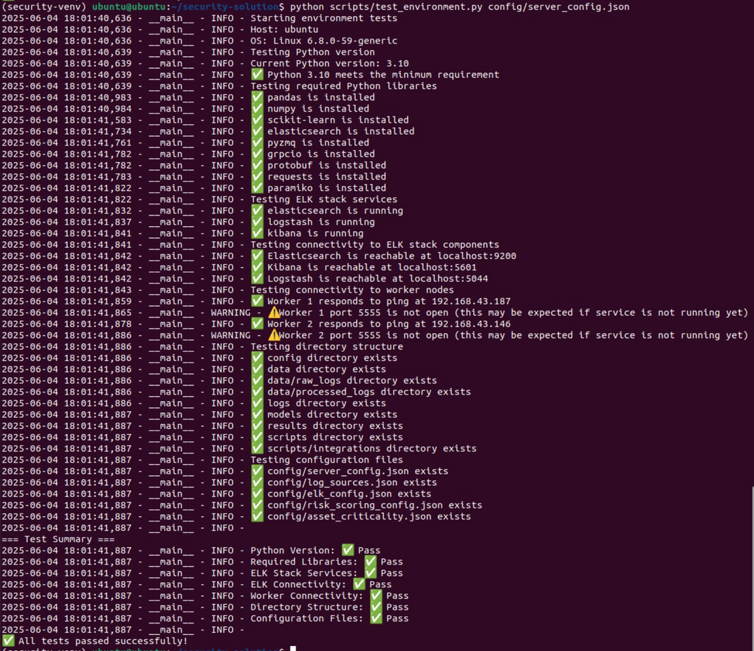
ML FILES
Threat Classification
Test Environment
Notes:
Finally, we have the Threat Classification and Test Environment modules.
On the left, Threat Classification uses supervised machine learning to categorize anomalies detected by the previous modules. Based on historical data and predefined threat types, it labels each incident—such as brute-force attacks, malware, or privilege escalation—making response and reporting much faster and more accurate.
On the right is the Test Environment script. This module validates that all system components, libraries, and configurations are working as expected before security analytics begin. It runs automated checks for dependencies, service connectivity, and even simulates common attack scenarios to ensure the entire detection pipeline is ready.

Slide 16
RESULTS ACHIEVED
Notes:
Now, let’s look at some results we achieved during our tests and deployment.

Slide 17


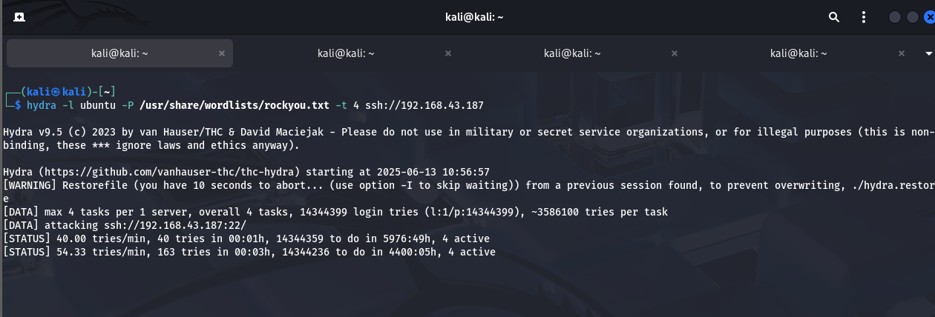
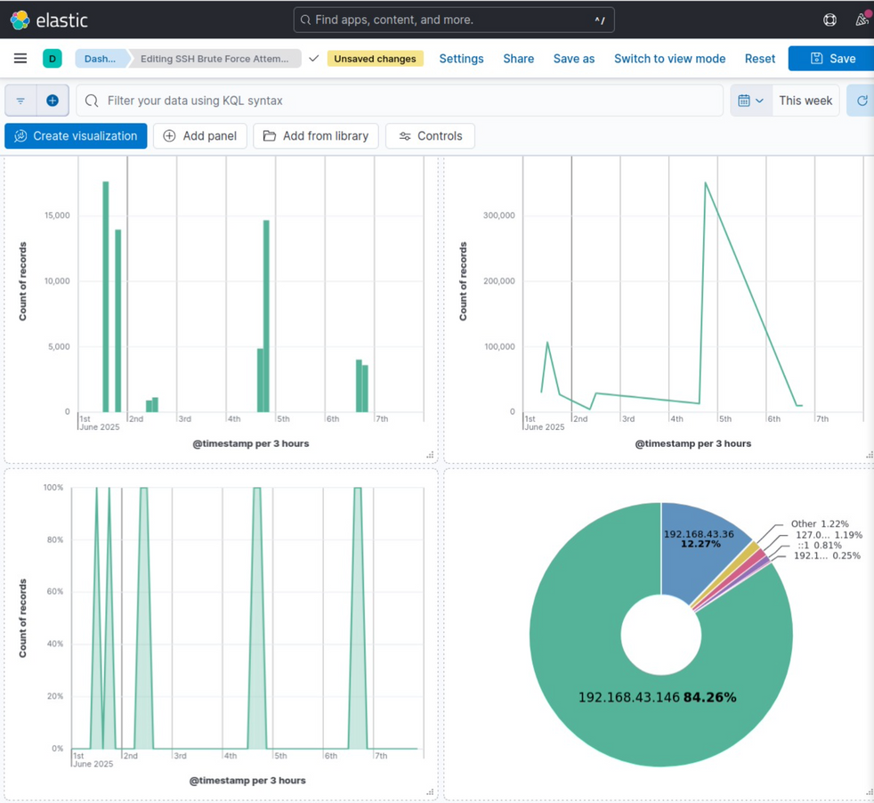

BRUTE FORCE SSH
Notes:
Slide 17 – this is the first attack brute force ssh and here the dashboard shows the attack ,here the logs and here the visualisation
where an attacker repeatedly attempts to access a system via SSH. Our system identified that over 84% of the traffic came from a single suspicious IP address. Thanks to our ML pipeline and real-time log monitoring, this threat was detected and flagged immediately.

Slide 18
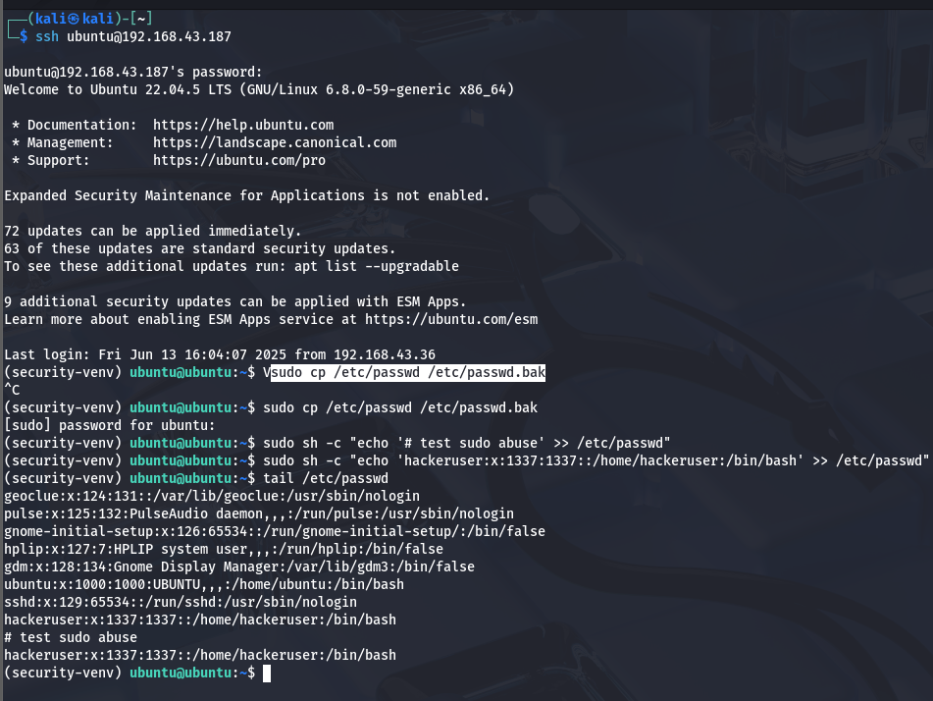
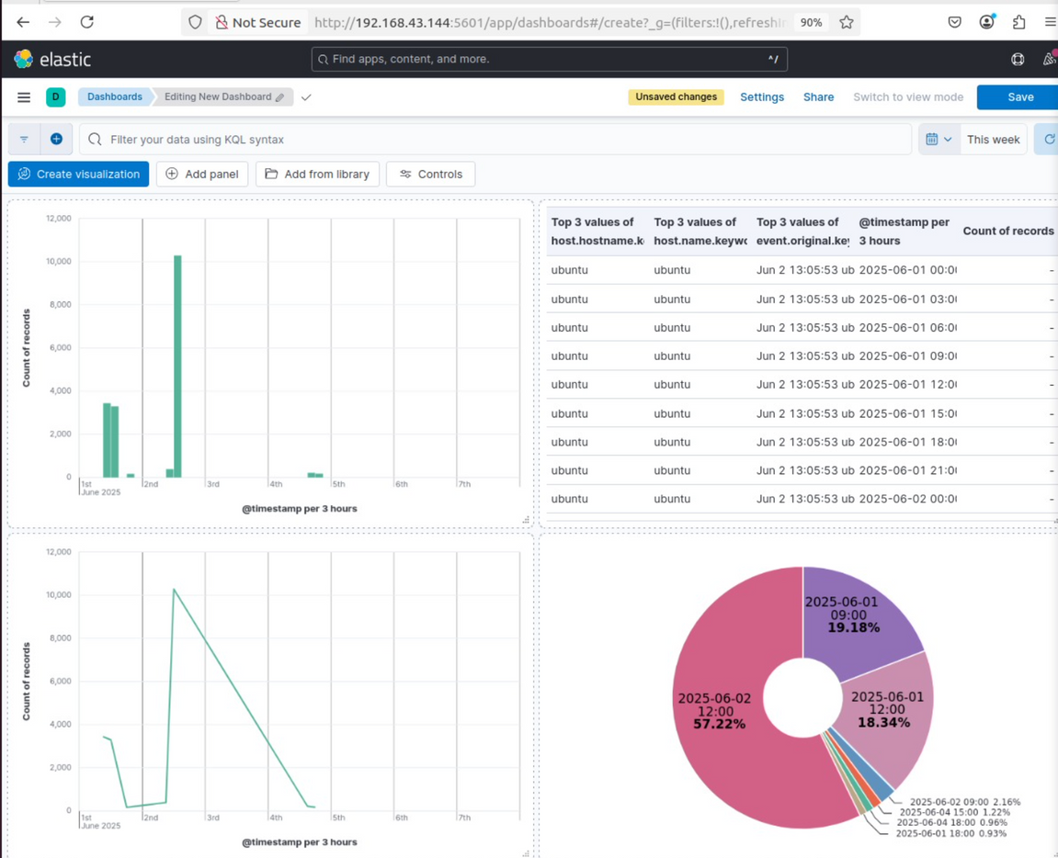
SUDO ABUSE
Notes:
SUDO ABUSEThis dashboard highlights potential sudo command abuse. Such behavior often follows a successful intrusion, where attackers try to escalate their privileges. Our detection logic correlated high sudo activity within a short time window, helping us flag and investigate this behavior.

Slide 19

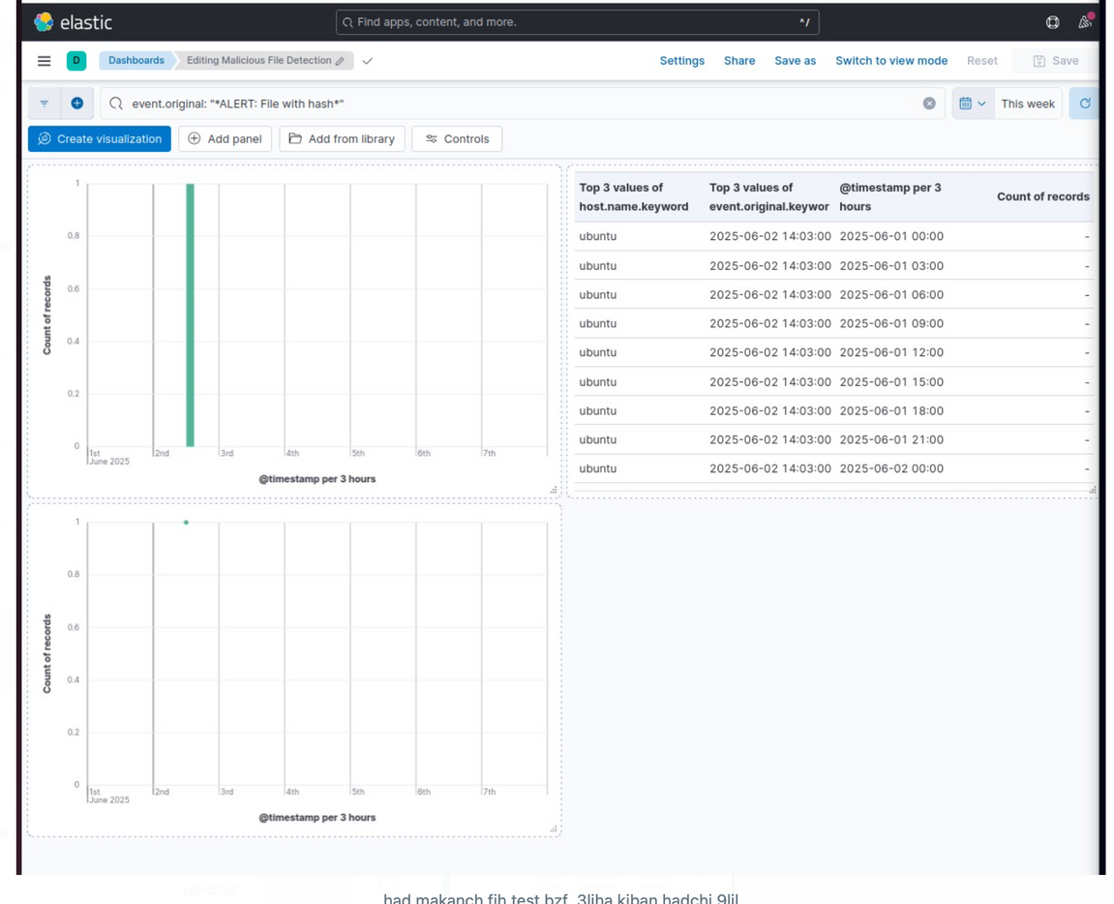


MALICIOUS FILE DETECTION
Notes:
MALICIOUS FILE DETECTIONHere, we detected a suspicious file by analyzing its hash and comparing it to known threat databases. Although only a few occurrences were found, it’s often these rare events that indicate sophisticated attacks. This system enables real-time alerts before damage is done.

Slide 20

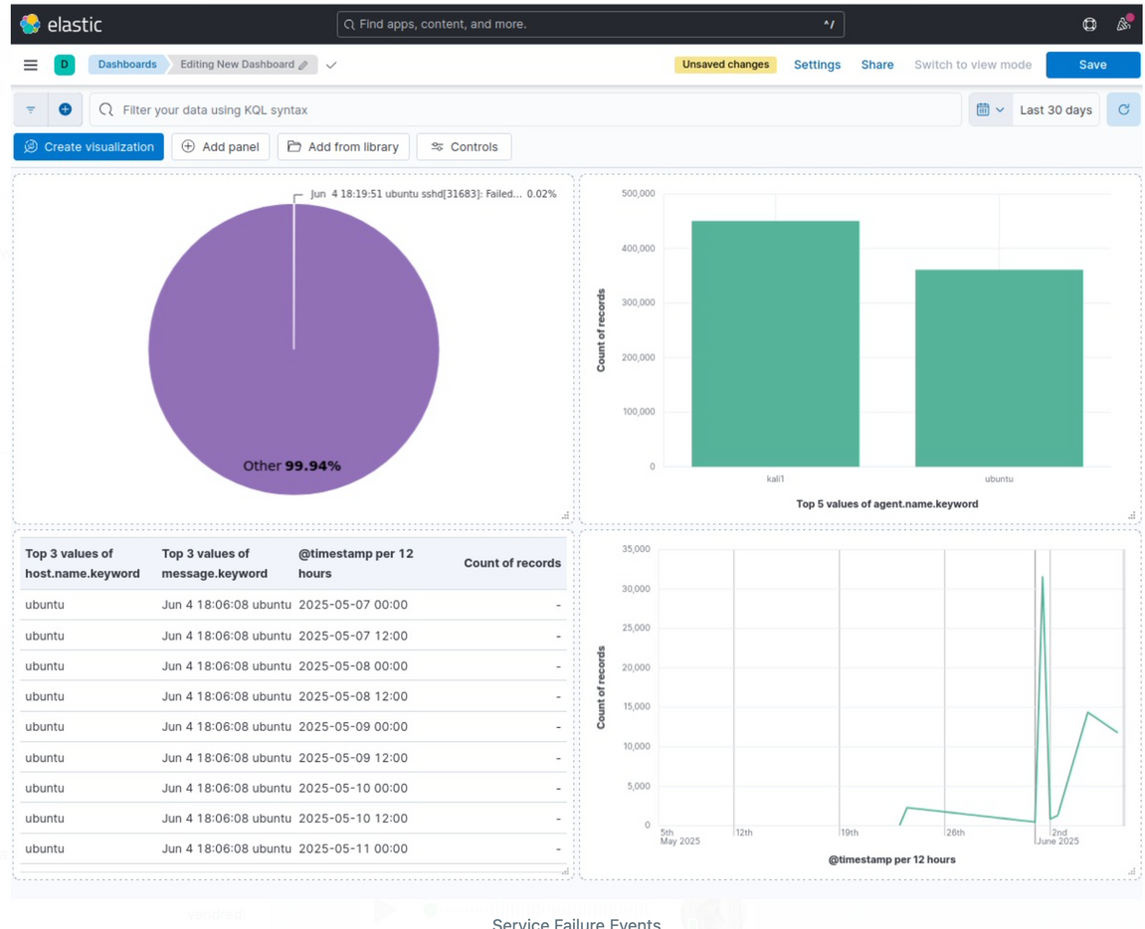

SERVICE FAILURE EVENTS
Notes:
SERVICE FAILURE EVENTSThis dashboard focuses on service failure events. For instance, a failed SSH daemon restart could indicate a DoS attack or configuration error. By collecting logs from multiple agents and correlating them over time, we can detect availability issues before they escalate.

Slide 21
CHALLENGES AND ISSUES FACED
Notes:
Before concluding, let’s discuss some of the key challenges we faced during this project.

Slide 22


CHALLENGES AND ISSUES FACED
INTEGRATION DIFFICULTIES
Data Quality & Log Normalization
Resource Constraints
Error Handling & Debugging
Notes:
No project is without its obstacles, and our journey was no exception. Here are some of the main challenges we faced:
Integration Difficulties: Connecting all the different components—especially ensuring smooth communication between the ELK Stack, OpenVAS, and our machine learning scripts—was a major hurdle at the beginning.
Data Quality & Log Normalization: We encountered inconsistent log formats and noisy data, which required significant effort to normalize and preprocess before analysis.
Resource Constraints: Limited CPU and memory on our virtual machines made it challenging to run multiple tools and scripts simultaneously, affecting system performance.
Error Handling & Debugging: Debugging real-time pipelines and identifying the sources of errors—especially when logs were missing or services failed—took extra time and patience.
Compliance Automation Complexity: Automating compliance checks, particularly with different benchmarks like Lynis and NIST, added another layer of technical complexity.
Security & Access Issues: We also had to carefully manage access rights and security configurations across VMs to avoid exposing sensitive components or interrupting data flows.
Despite these challenges, our team collaborated effectively and was able to overcome each issue, making our final solution both robust and reliable.

Slide 23
live simulation
June 2025

Slide 24
THANK YOU !
June 2025
Notes:
To wrap up, here’s our conclusion and some closing thoughts.

